Slide 1


JANSONS INSTITUTE OF TECHNOLOGY
(An Autonomous Institution)
Approved by AICTE, New Delhi and Affiliated to Anna University, Chennai
Accredited by NAAC and ISO 9001:2015 certified Institution
Coimbatore, Tamil Nadu – 641659
BIO-SENSOR BASED SMART VENTILATING SYSTEM USING AMBU BAG FOR EMERGENCY INHALATION AID
BLYNK BIOMED
TEAM MEMBERS: PRANESH S TEAM GUIDE: Prof. N. KRISHNAPRIYA
NOOR AARIFA A INNOVATION AMBASSADOR
SUBARNA C DEPT OF ECE
PRIYADHARSHINI S
Dept. of ECE – III year

Slide 2
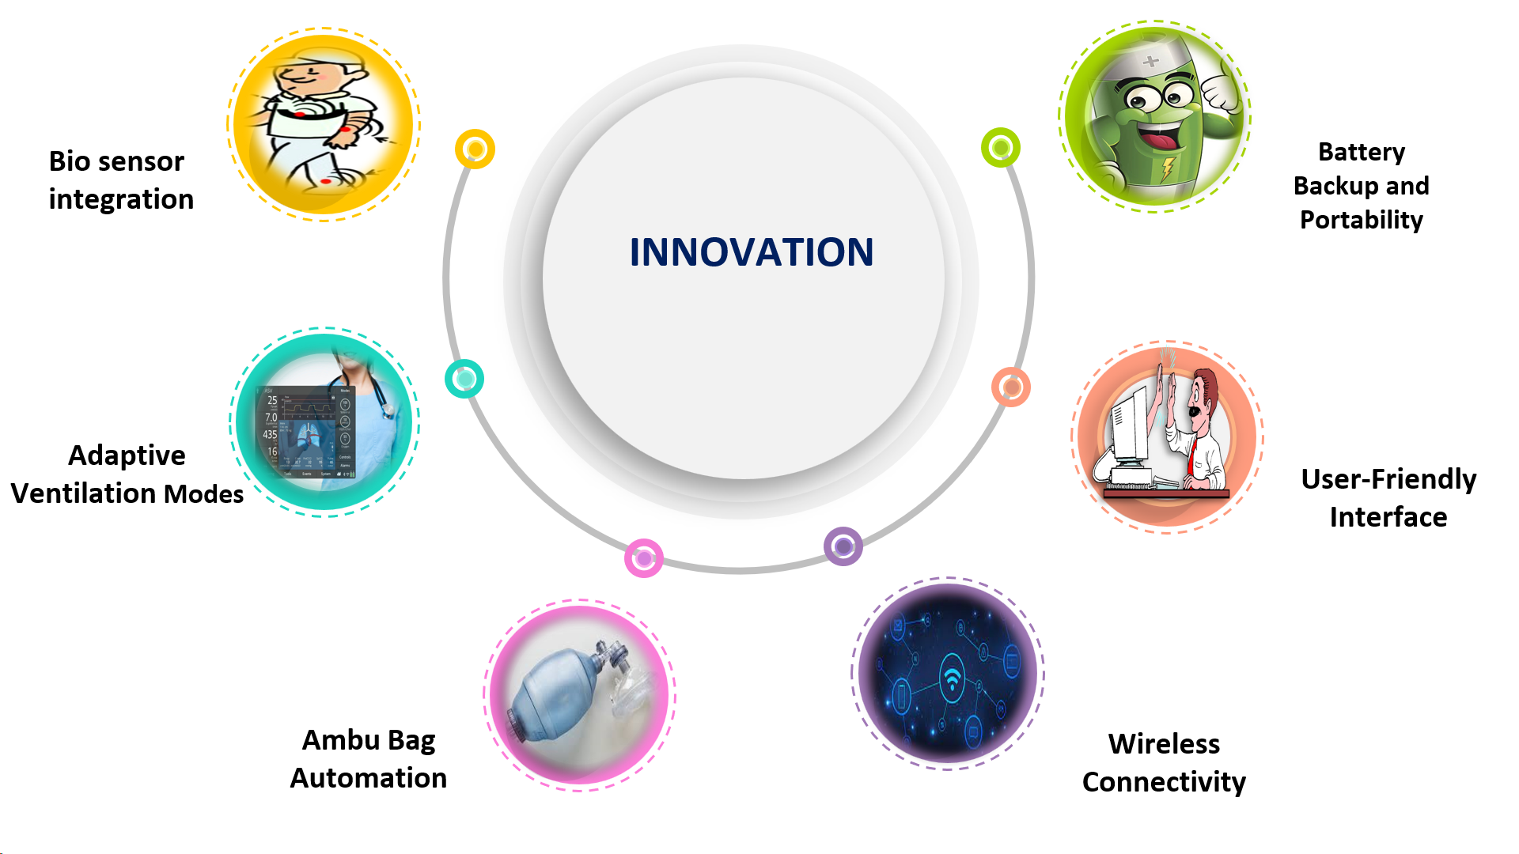
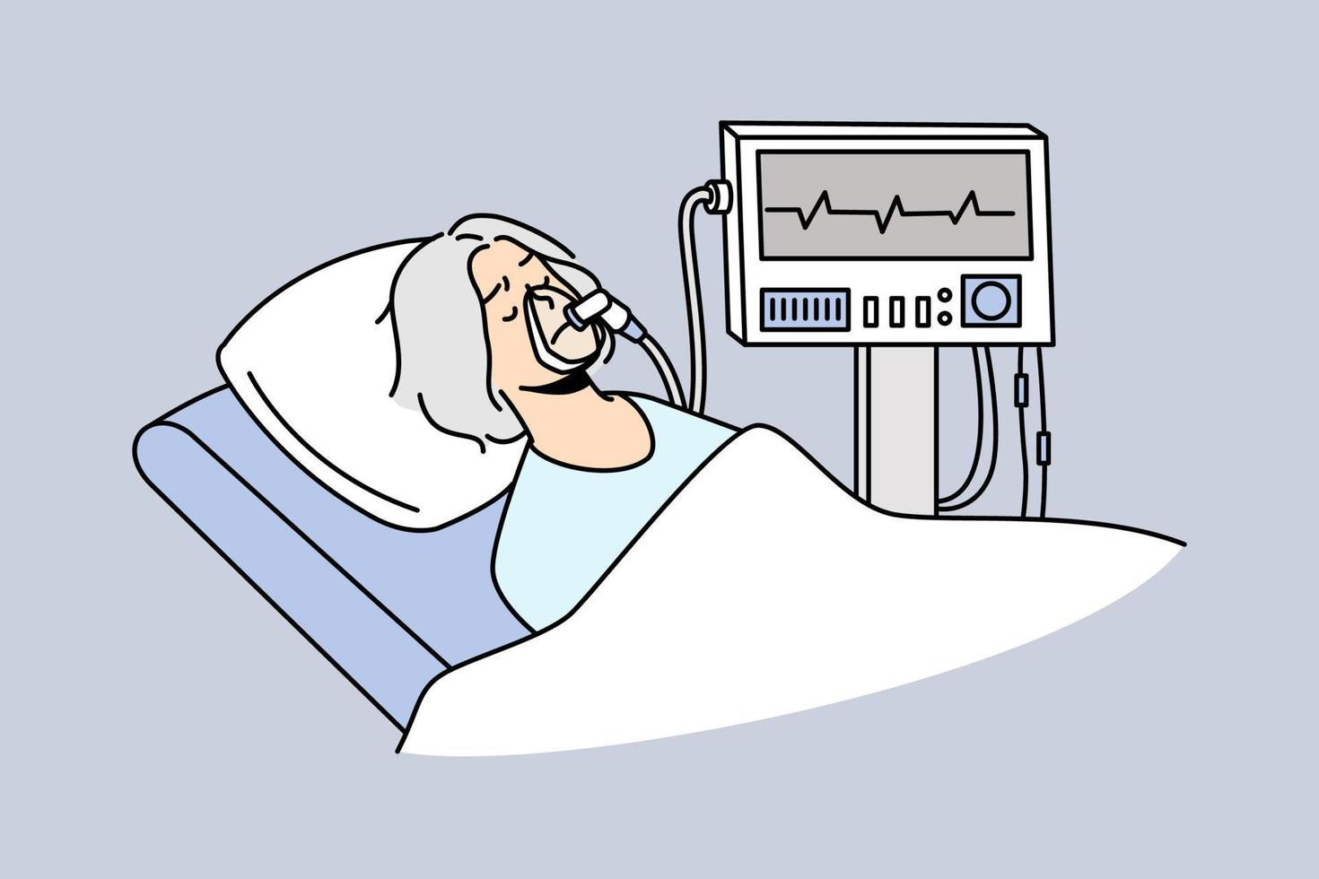
What is the innovation in your idea?

Slide 3
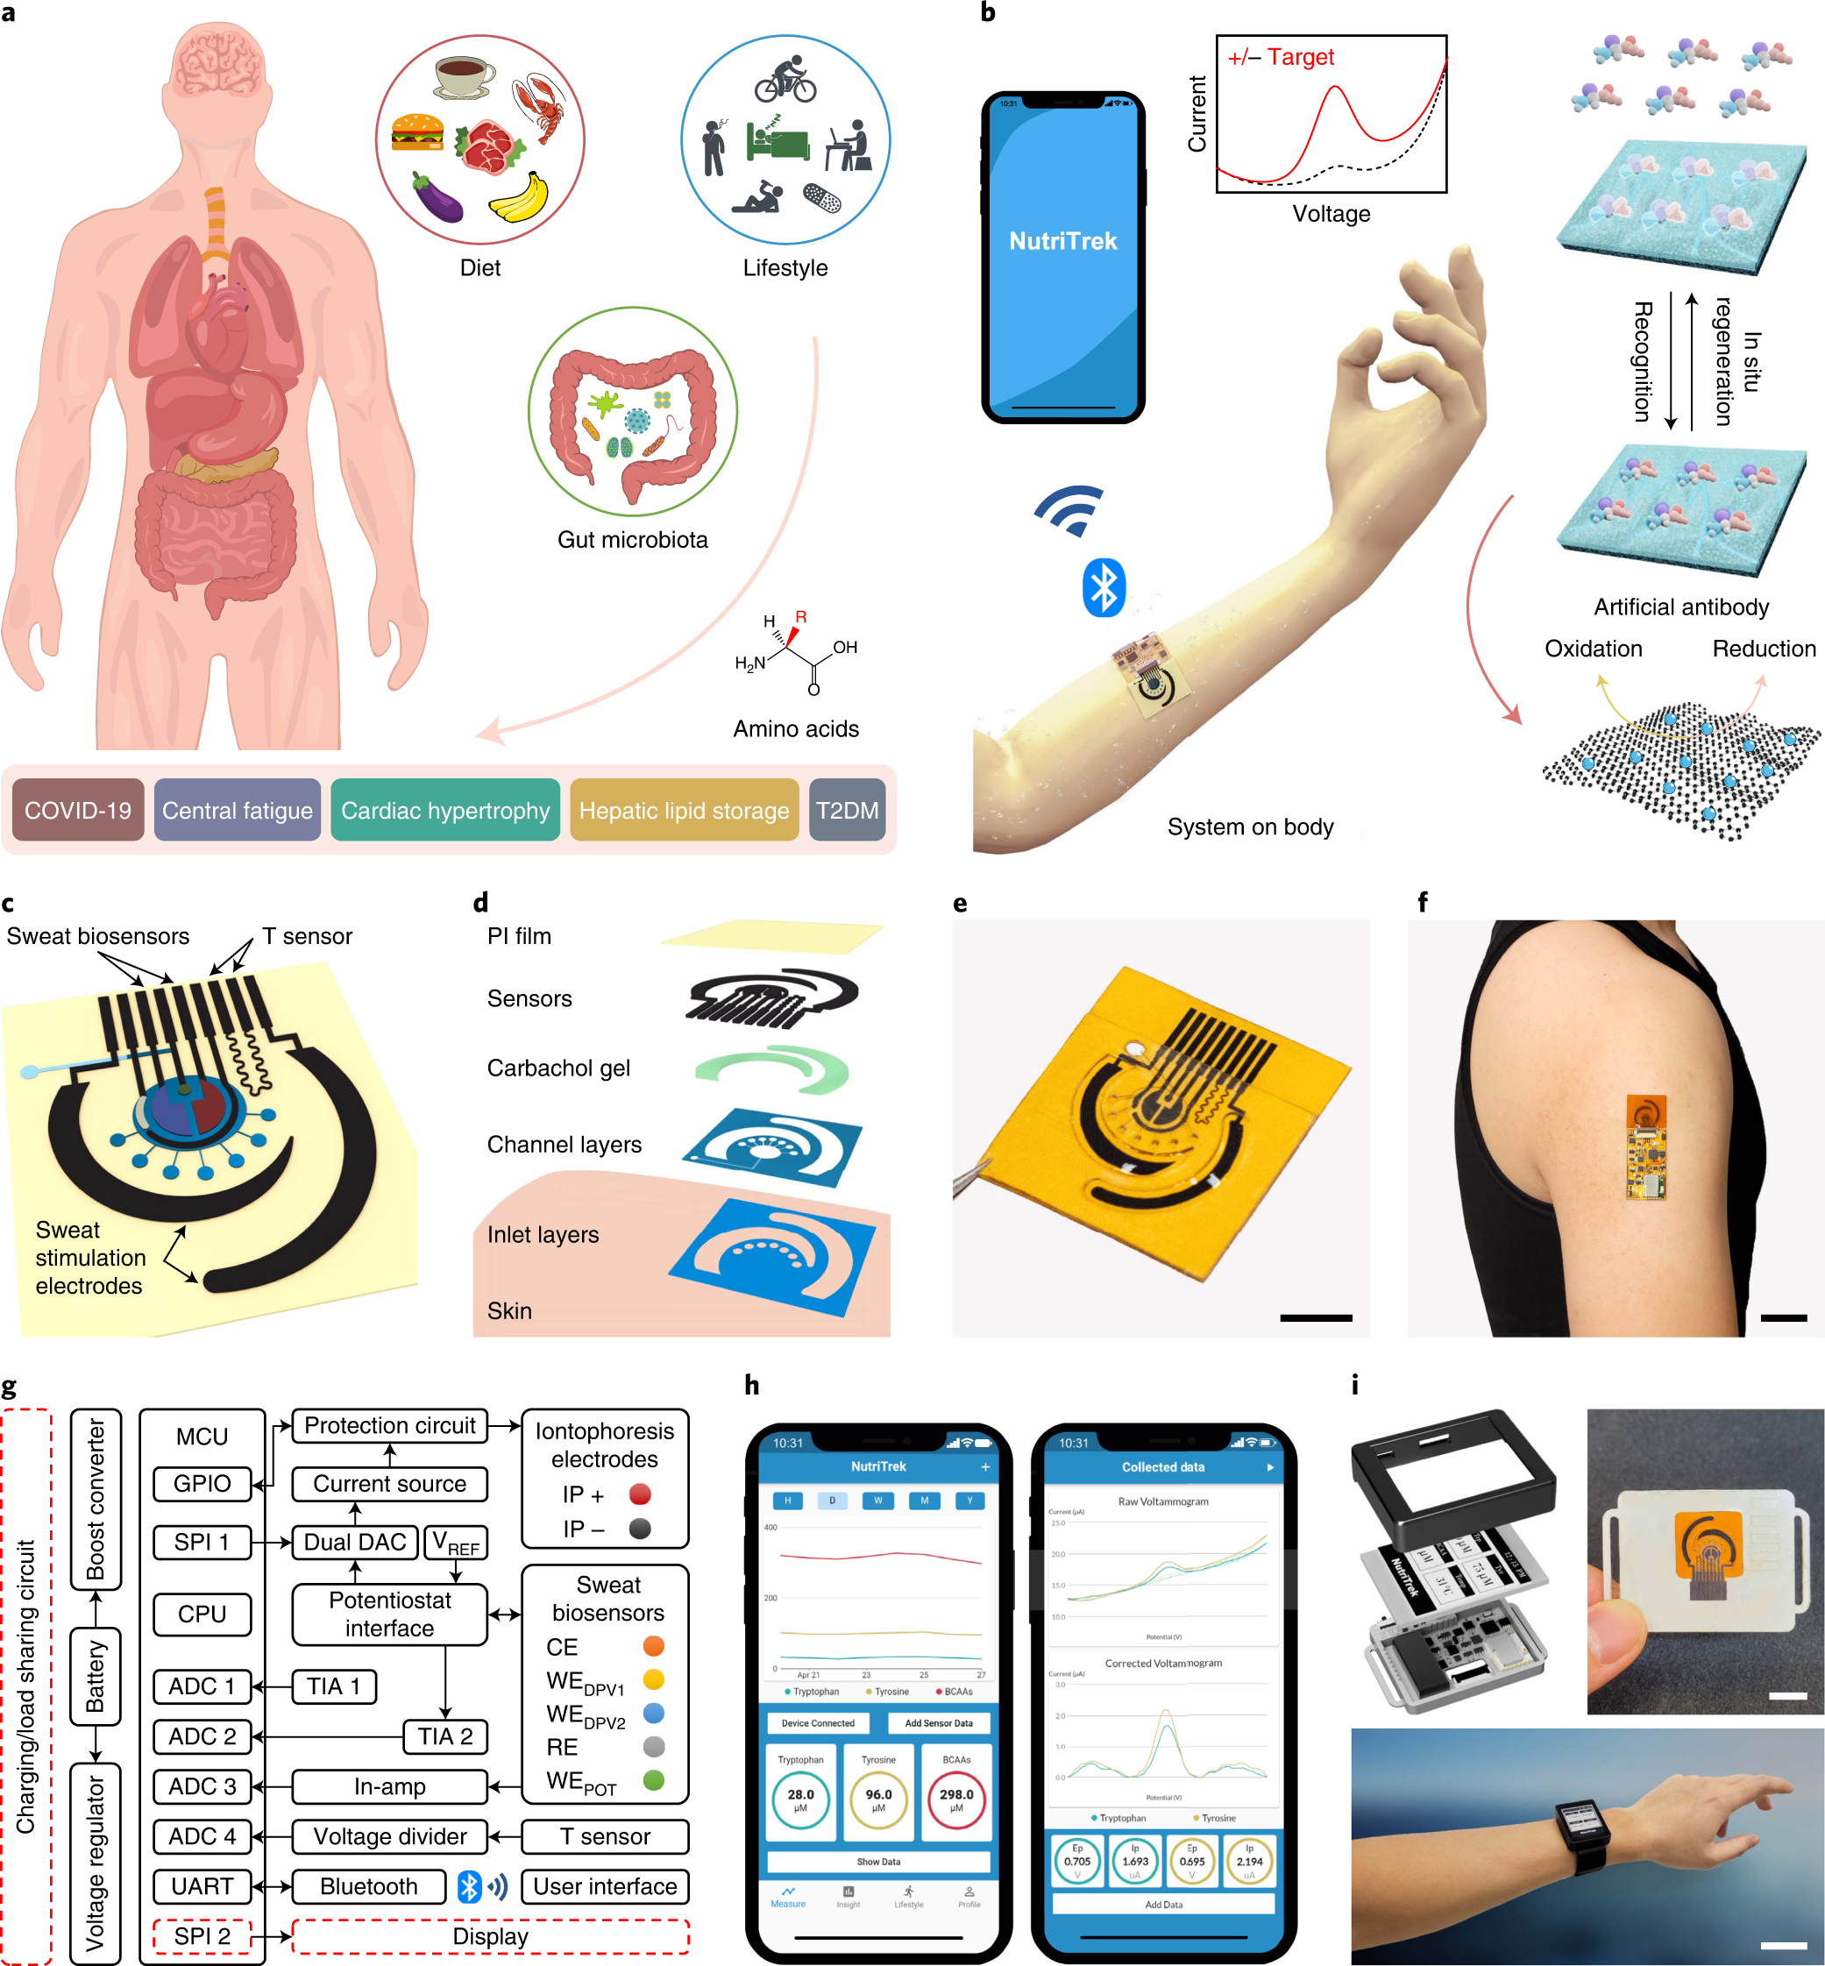
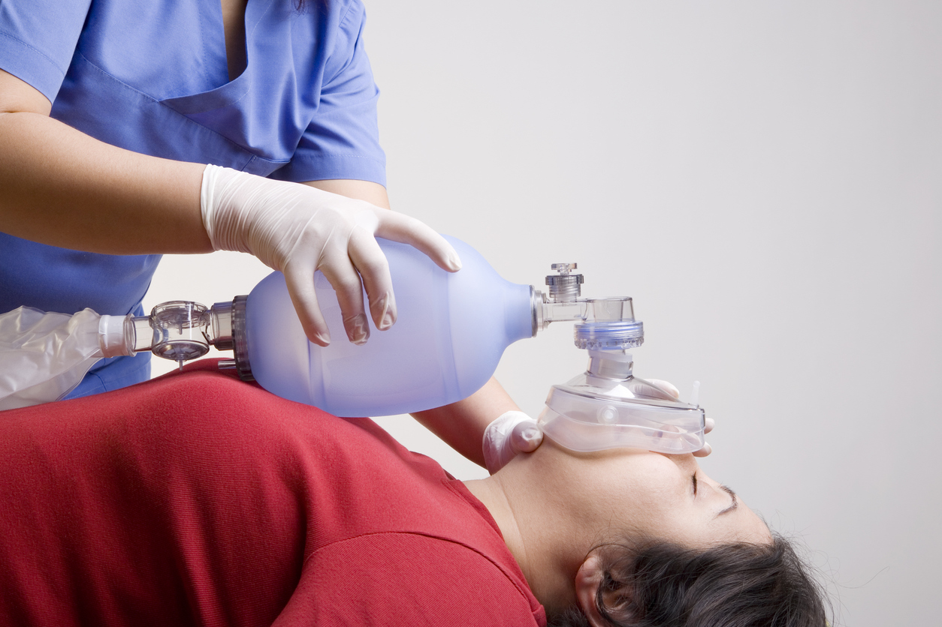

Key Differentiators:
Advanced bio-sensors that can detect various physiological parameters such as respiratory rate, oxygen saturation levels, and heart rate.
These sensors would continuously monitor the patient's condition in real-time.
To monitor real-time patient condition we use reliable, efficient & portable using IoT enabled by cutting edge technology.
This enables instantaneous action and remote monitoring even from a distance.
Design a user-friendly interface for both healthcare professionals and lay users.
This interface should provide clear visualizations of the patient's physiological parameters and allow for easy adjustment of ventilation settings if needed.

Slide 4
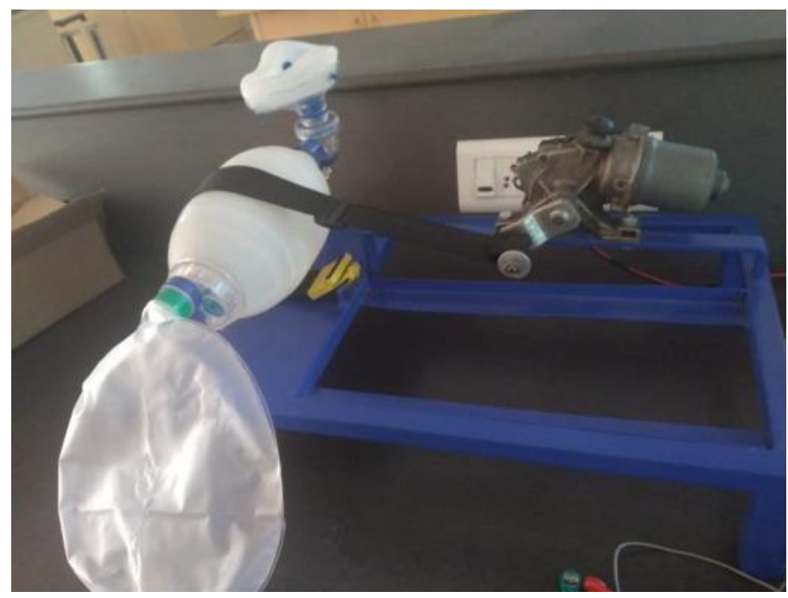
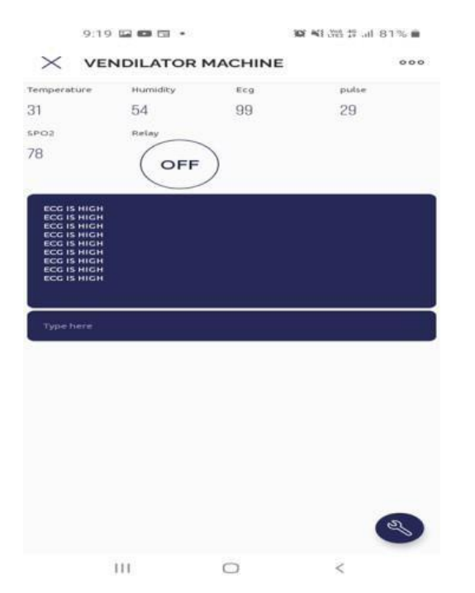
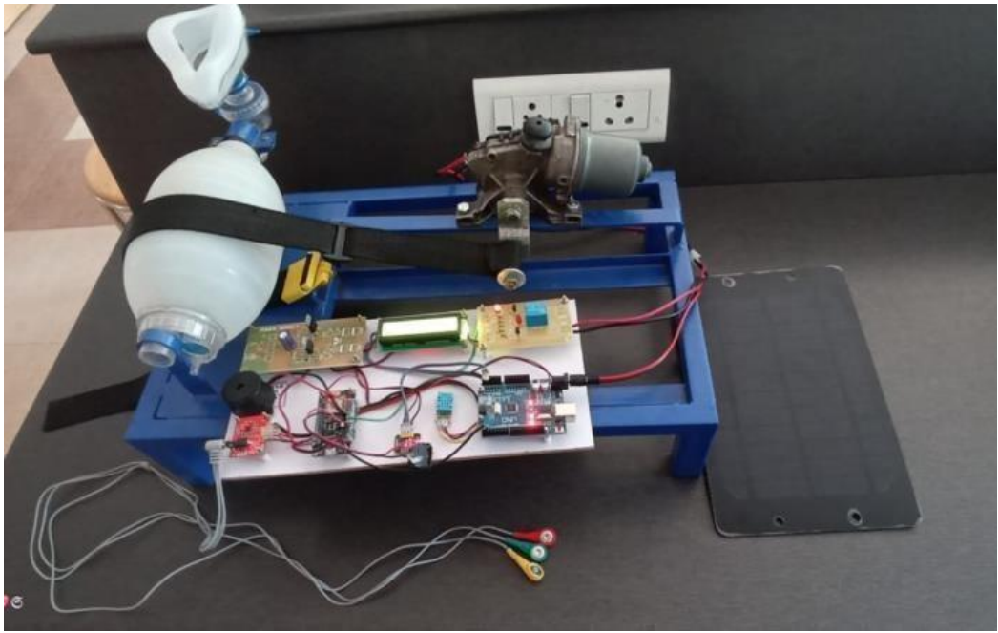
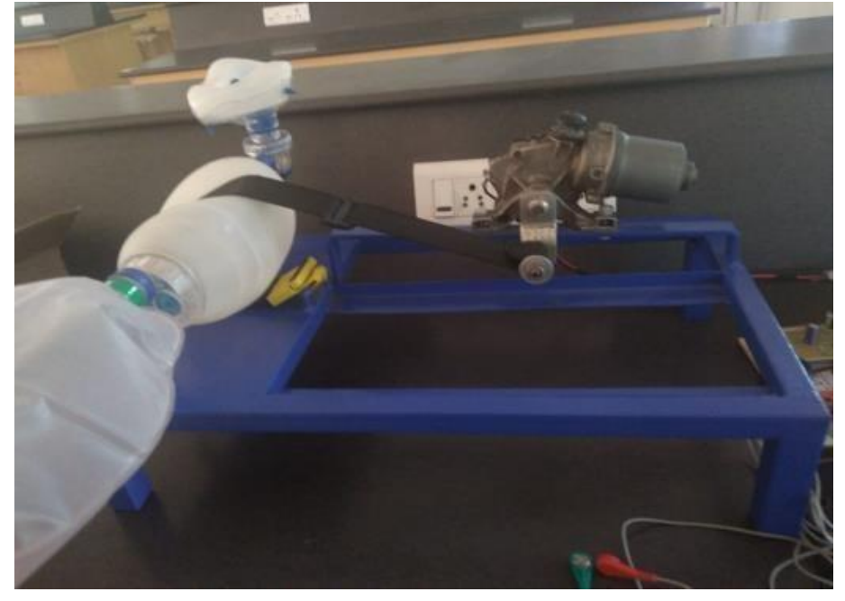
Prototype/Proof of concept
.
SYSTEM IN OFF STATE
EXPERIMENTAL SETUP
Video link
https://www.youtube.com/watch?v=GN53roUfwgk
Real Time Monitoring Via App
SYSTEM IN ON STATE

Slide 5





Future Plans/potential next steps
.
REAL TIME MONITORING & ALERTS
INTEGRATION WITH TELEMEDICINE PLATFORMS
MACHINE LEARNING ALGORITHMS
ENHANCED IoT CONNECTIVITY
ENHANCED SENSOR INTEGRATION
To make secure reliable data accurancy for connectivity
Implement automated alerts & notifications to alert healthcare providers
Integrate the trained machine learning model into the ambu bag system which adjust ventilation parameters baed on patient respiratory pattern
This could enable virtual consultations between patients and healthcare providers, facilitating remote diagnosis & treatment planing
Integrate bio sensors to monitor needed inhalation support for Asthuma patients & covid19 patients
STAGE 03

Slide 6
Technical Details and Reports
5.Evaluation:
During evaluation, our project mentor gave suggestions to enhance the prototype and motivate to proceed for product development.
3.Development:
For developing the Prototype , we used the lab sensors to implement the Prototype and For checking feasibility of our idea
1.Analysis:
During research in COVID-19, insufficient ventilators caused patients to die, so we had the idea to make low-cost ventilators.
I
E
A
D
D
2.Design:
We wished to develop a user-friendly product using Bio-sensors and reducing the size of the normal ventilators for patients
4.Implementation:
After the development, of prototype is evaluated in laboratory environment(TRL-3).

Slide 7
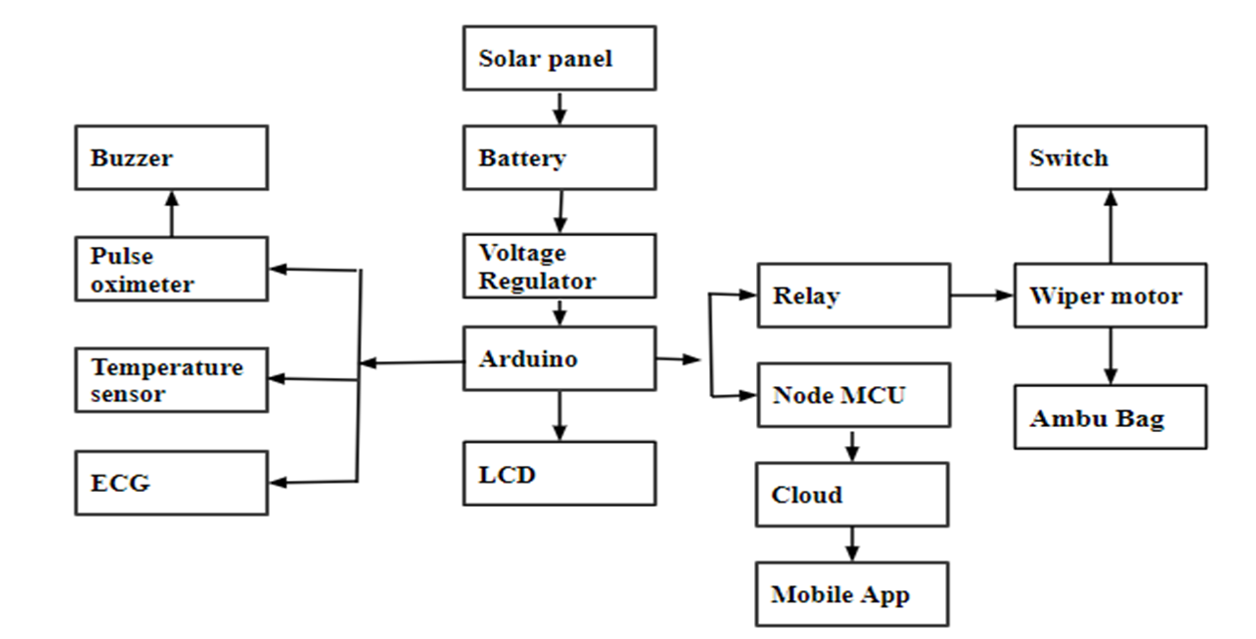
BLOCK DIAGRAM
FIGURE-01: BLOCK DIAGRAM OF BIO-SENSOR BASED SMART VENTILATING SYSTEM USING AMBU BAG (TRL-1)

Slide 8
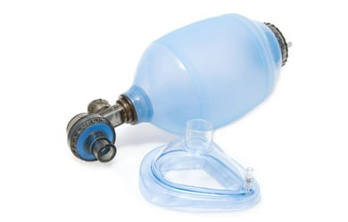
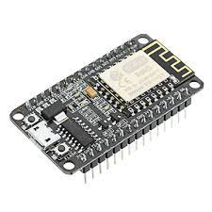
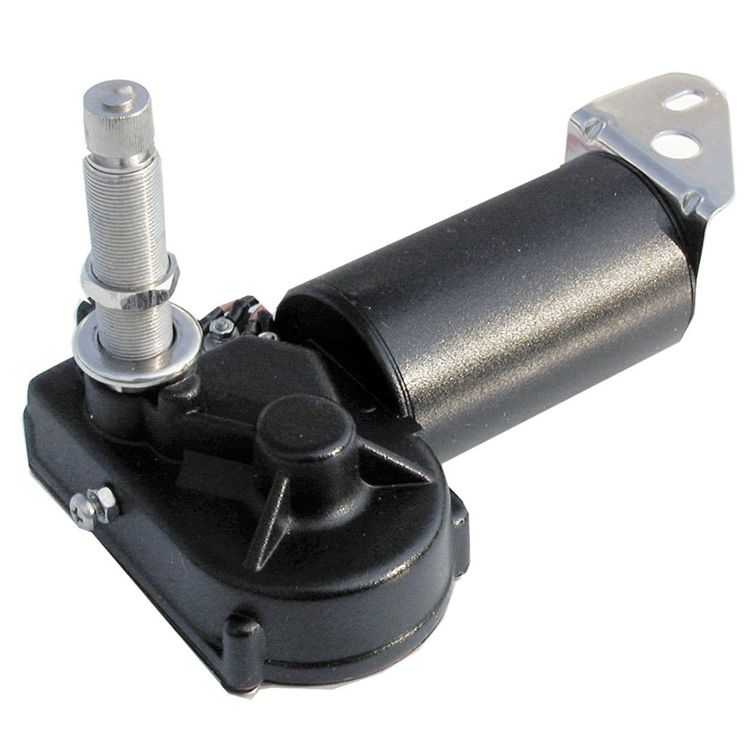
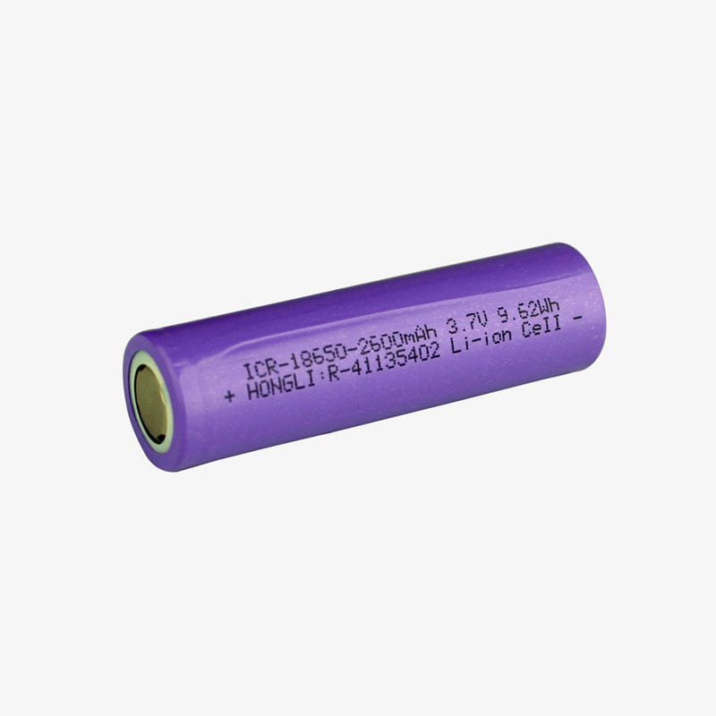
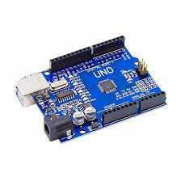
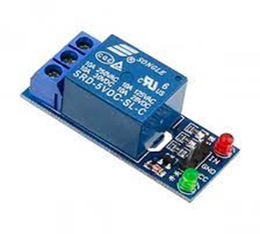
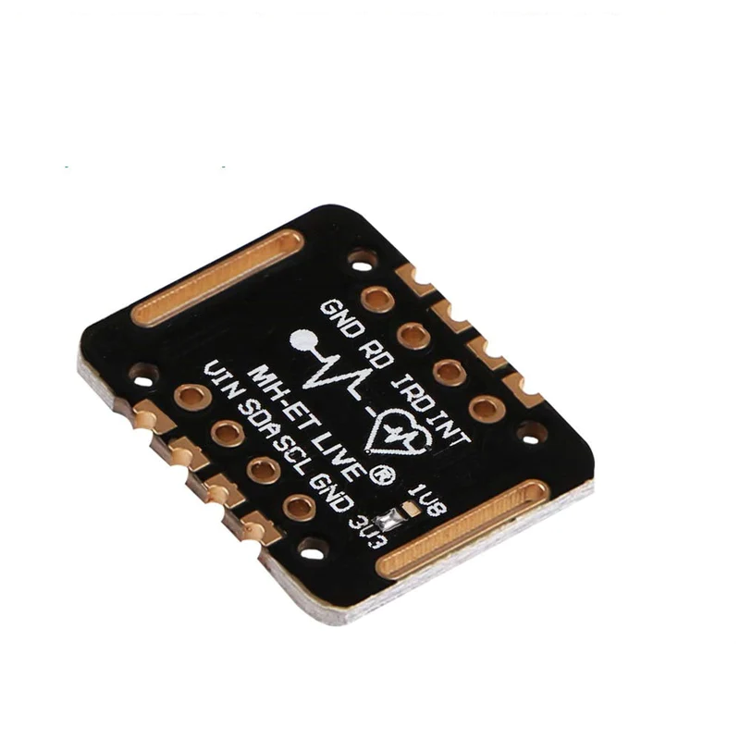
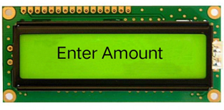
HARDWARE COMPONENTS
Ambu Bag With Respiratory Mask
Battery
DC Wiper Motor
ESP8266
Relay
Pulse Oximeter
LCD Display
Arduino UNO

Slide 9
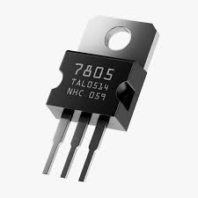
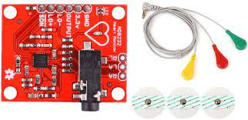
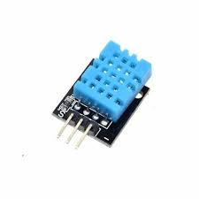
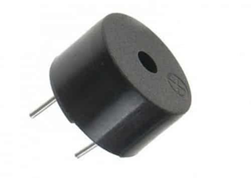
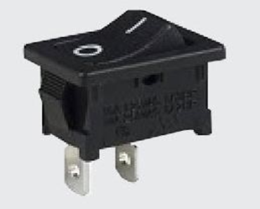
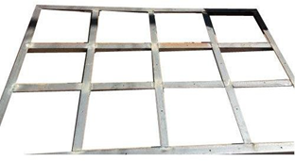


Voltage Regulator
DHT11 Temperature Sensor
AD8232 ECG Sensor
Buzzer
Software used
Steel frame
Switch

Slide 10
Thank you
THANK YOU

